Slide 1

Automated generation of protocol dissectors for Wireshark.

Slide 2
Agenda
The Team
The Task
Preliminary Study
Implementation
Demo
Questions and Answers

Slide 3
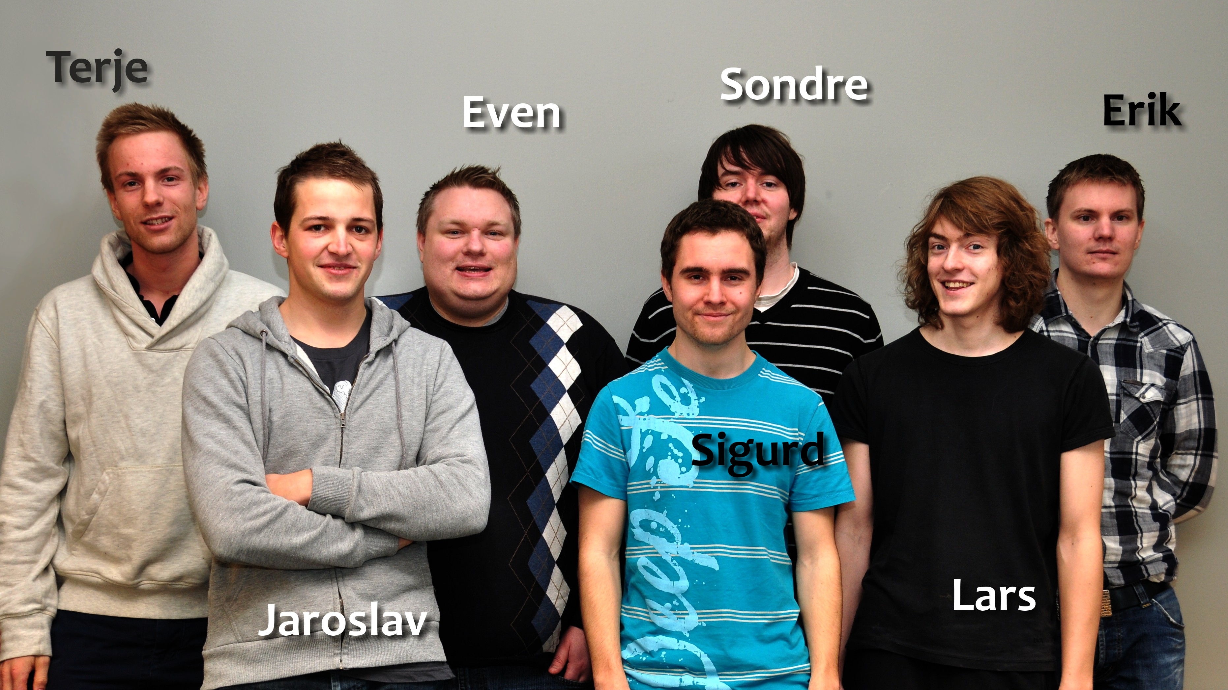
The Team

Slide 4

International company
Security and mission critical components
Both military and civil customers

Slide 5
The Task
Process 1
Process 2
ID: 42
1001101010
struct message {
int a = 5;
int b = 6;
char* c = ‘abc’;
};
struct message {
int a = 5;
int b = 6;
char* c = ‘abc’;
};
Wireshark
ID: 42
1001101010
struct message {
int a = 5;
int b = 6;
char* c = ‘abc’;
};

Slide 6
Dissectors
Wireshark can be extended with dissectors
A dissector decodes the structure of a message
Written in Lua.
Takes from 15 minutes – 1 hour to make.
Requires knowledge about C memory layout and Wireshark API.

Slide 7
The Task
Generate Lua dissectors for C structs automatically
4000 C-header files
Some very complex
Provide configuration options for the dissectors
ID
Member and type semantic
Options to make it work in different environments

Slide 8










Preliminary Study
cppheaderparser
Attest
PLY
configparser
py.test
ConfigObj
coverage.py
pycparser
nose

Slide 9
Development Methodology
Agile development
Scrum
4 sprints
2 weeks each

Slide 10
Sprint #1 Goals
C header and configuration as input
Basic C data types
#include, #if and #define
Valid ranges for struct members
Generate dissectors for simple structs
Test third party libraries

Slide 11
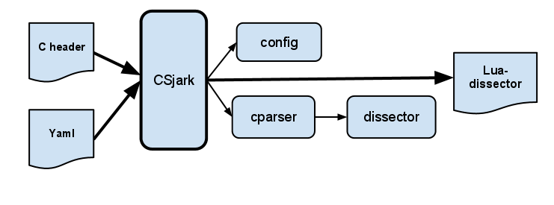
Sprint #1 System Overview

Slide 12

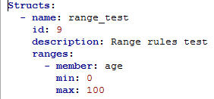
Config of Range Limit

Slide 13
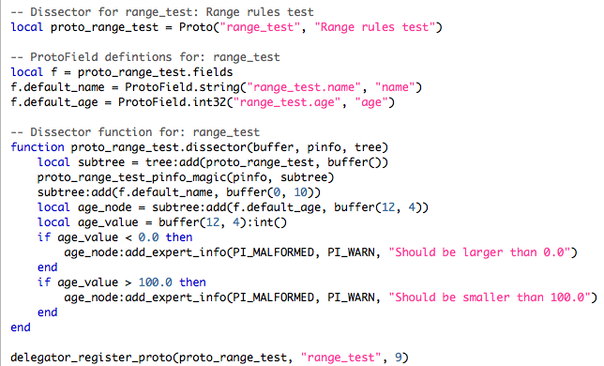
Lua Dissector

Slide 14
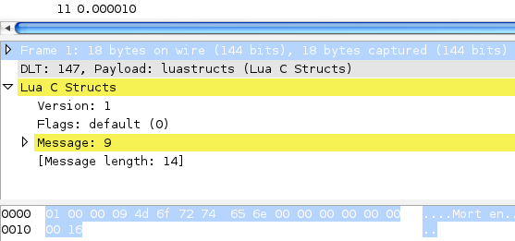
Wireshark Without Dissector

Slide 15
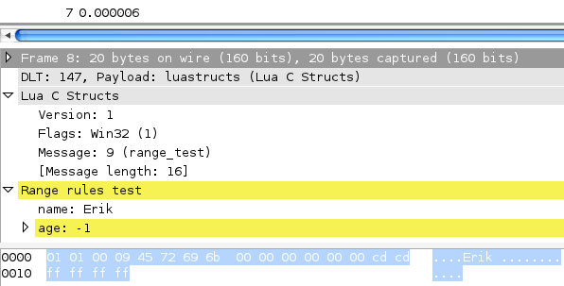
Wireshark With Dissector

Slide 16
Sprint #2 Goals
Nested structs
Arrays
Enums
Bitstrings
Dissector ID
Batch processing
Trailers
Custom handling of specific data types

Slide 17
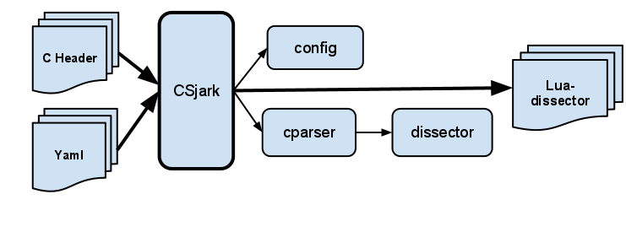
Sprint #2 System Overview

Slide 18
Sprint #3 Goals
Different platforms
Union
Configuration for custom Lua files
Filter and search on attributes in Wireshark
Member size and memory alignment
Bug fixes
Running the customer examples

Slide 19
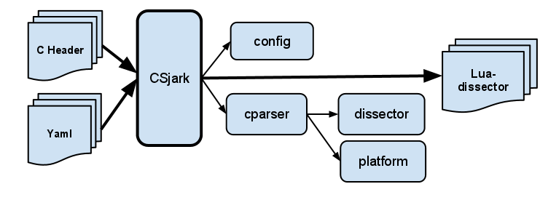
Sprint #3 System Overview

Slide 20
Platform support
Dissector table(id, dissector)
Message
ID = 10
Flag = WIN32
Size = 72
10101110100010011100100111100110101000110101
Dissector(flag)
Platform dependent dissector function

Slide 21
Status before sprint #4
The utility failed to parse most of the customer code
Some bugs and unforseen problems caused the utility to crash
Thales made arrangements to let us do on-site testing on target code

Slide 22
Sprint #4 Goals
Parsing customers code
Bug fixes in the file traversing
Remove unsupported C pre-processor directives
Locate indirect includes
New requirements
Guess dissector from packet size
More options for batch mode
Automatically generate config templates

Slide 23
Indirect includes
a.h
typedef TYPE
…
//Processed
typedef TYPE
…
Use TYPE
…
…
source.c
#include <a.h>
#include <b.h>
…
Pre-processor
b.h
Use TYPE
…

Slide 24
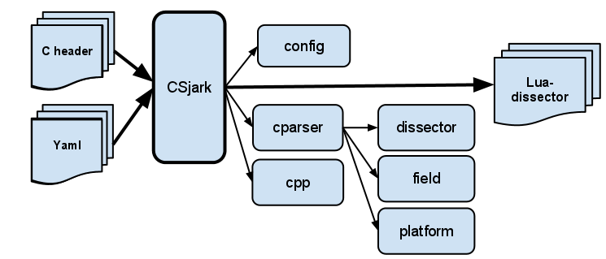
Sprint #4 System Overview

Slide 25
Testing
No access to real test data
Customer provided some examples
Needed to manually make messages packets
Challenging to keep all the tests up to date
Over all good code coverage

Slide 26
Result
Fulfilled all the initial customer requirements
Finished some of the additional requirements
Were able to parse most of the customers files one by one.
Memory constrictions made us unable to run the utility on all their code.
The customer was satisfied with the result.

Slide 27
Demonstration

